Slide 1
Sharding
Lecturer: Ngo Huy Bien
Software Engineering Department
Faculty of Information Technology
VNUHCM - University of Science
Ho Chi Minh City, Vietnam
nhbien@fit.hcmus.edu.vn

Slide 2

Objectives
To implement a data sharding prototype for a key-value storage database using consistent hashing.

Slide 3

Contents
Why Sharding?
Consistent Hashing.
Random Trees.

Slide 4

References
David Karger et al. (1997). Consistent Hashing and Random Trees.
Ben Appleton and Michael O'Reilly (2015). Multi-Probe Consistent Hashing.
Vahab Mirrokni et al. (2017). Consistent Hashing with Bounded Loads.

Slide 5
Why Sharding?
Unlimited storage.
Performance.

Slide 6
Storing Images on One Server
1 request handler server (s1), 1 storage server (s2).
Inputs: username, image file name, image content
Outputs: URL.
Examples
URL1: https://images.facebook.com/minh/image1.png
URL2: https://images.facebook.com/minh/image2.png
URL3: https://images.facebook.com/minh/image3.png
Solution: Use URL as key, image content as value.

Slide 7
Example
Id | Key | Value
1 | URL1 | [image1 content]
2 | URL2 | [image2 content]
3 | URL3 | [image3 content]
4 | URL4 | [image4 content]
5 | URL5 | [image5 content]
6 | URL6 | [image6 content]
7 | URL7 | [image7 content]

Slide 8
Storing Images on Three Servers
1 request handler server (s1), 3 storage servers (s2, s3, s4).
Inputs: username, image file name, image content.
Outputs: URL.
Examples
URL1: https://images.facebook.com/minh/image1.png
URL2: https://images.facebook.com/minh/image2.png
URL3: https://images.facebook.com/minh/image3.png
URL4: https://images.facebook.com/thao/image1.png
Solution: Use URL as key. Use rand(2, 3, 4) to choose a server to store the image content.

Slide 9
Example Data
Key | Server # | Data
URL1 | 2 | -> [image1 content]
URL2 | 3 | -> [image2 content]
URL3 | 4 | -> [image3 content]
URL4 | 3 | -> [image4 content]
URL5 | 4 | -> [image5 content]
URL6 | 2 | -> [image6 content]
URL7 | 2 | -> [image7 content]

Slide 10
How to Retrieve the File for URL?
Solution: Use the mapping table to find server id for URL.
Key | Server # | Data
URL1 | 2 | -> [image1 content]
URL2 | 3 | -> [image2 content]
URL3 | 4 | -> [image3 content]
URL4 | 3 | -> [image4 content]
URL5 | 4 | -> [image5 content]
URL6 | 2 | -> [image6 content]
URL7 | 2 | -> [image7 content]

Slide 11
Mapping Table is too Large?
Solution: Use a hash function (Mod, Luhn Algorithm, MurmurHash3).
Convert URL to a number. Prehash(URL) = Number.
Server index = [(Number) mod (# of servers)] + 2. There is no need to store server indexes in a table. They can be computed on the fly.
Prehash (URL1) = 3, (3 mod 3) + 2 = 2.
Prehash (URL2) = 4, (4 mod 3) + 2 = 3.
Prehash (URL3) = 5, (5 mod 3) + 2 = 4.
Key | Server # | Data
URL1 | 2 | -> [image1 content]
URL2 | 3 | -> [image2 content]
URL3 | 4 | -> [image3 content]

Slide 12
Server 2 is Full
Solution: Add new server (s5). Replace mod 3 by mod 4.
New problem: Having to move data from old server to new server.
Examples: s2 -> s3, s3 -> s2, s4 -> s3, s3 -> s4, s4 -> s5.
URL | Prehash | Server #
URL1 | 3 | 2
URL2 | 4 | 3
URL3 | 5 | 4
URL4 | 10 | 3
URL5 | 11 | 4
URL6 | 12 | 2
URL7 | 20 | 4
Server #
3
2
3
4
5
2
2

Slide 13


Slide 14
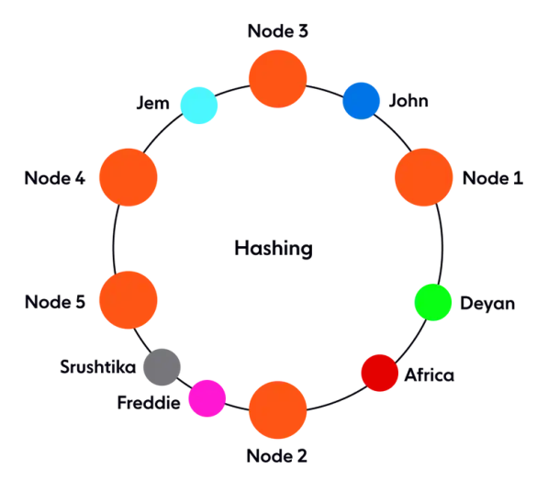
Consistent Hashing
Idea: Convert hash table to logical hash ring.
Hash both node identifiers and data keys using the same hash function.
Each server is mapped to a random number. Examples: hash("IP Address") = 24, hash(server name 2) = 49, hash(server name 3) = 35.
Store server numbers in a sorted array (or binary tree).
Each key is mapped to a random number. Example: hash(URL1) = 30.

Slide 15
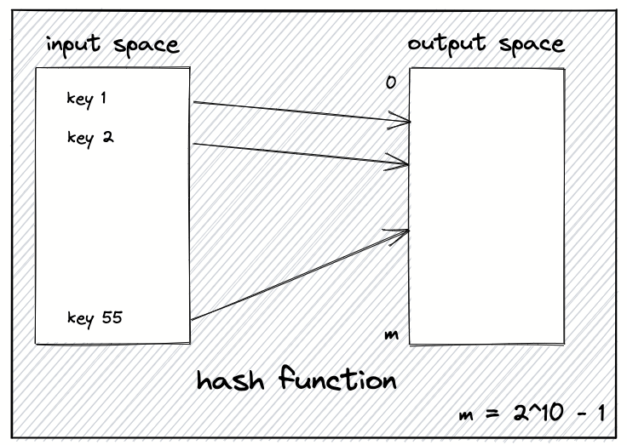
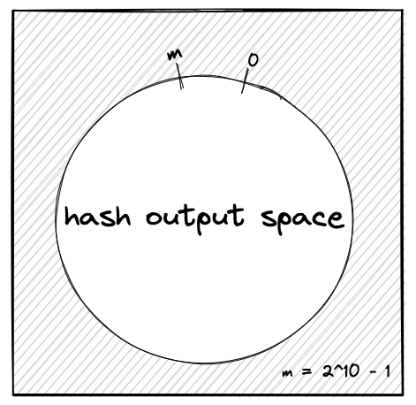
Hash Functions
Slow hash functions: CRC-32/MD5/SHA-1/SHA-256.
Cheaper hash functions: MurmurHash, xxHash.

Slide 16
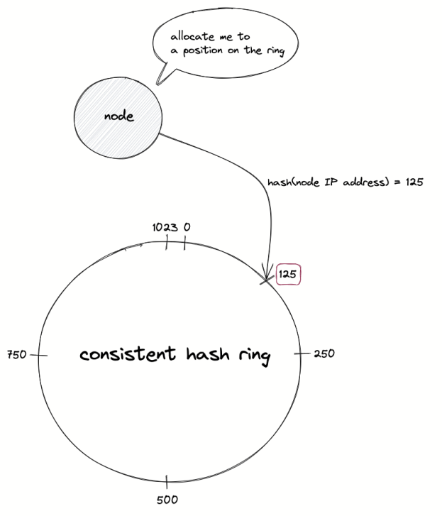
Positioning the Nodes on the Hash Ring

Slide 17
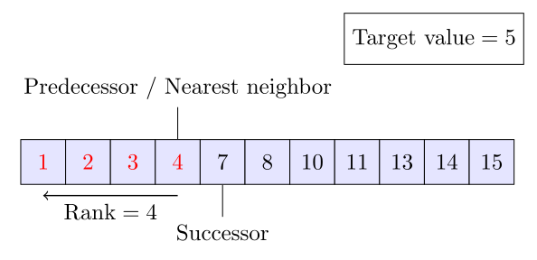
Finding Location for Server
Do binary search until you get down to a single element.
If there is a match, return it.
If there is no match, look at your next neighbor to find the closest match.

Slide 18
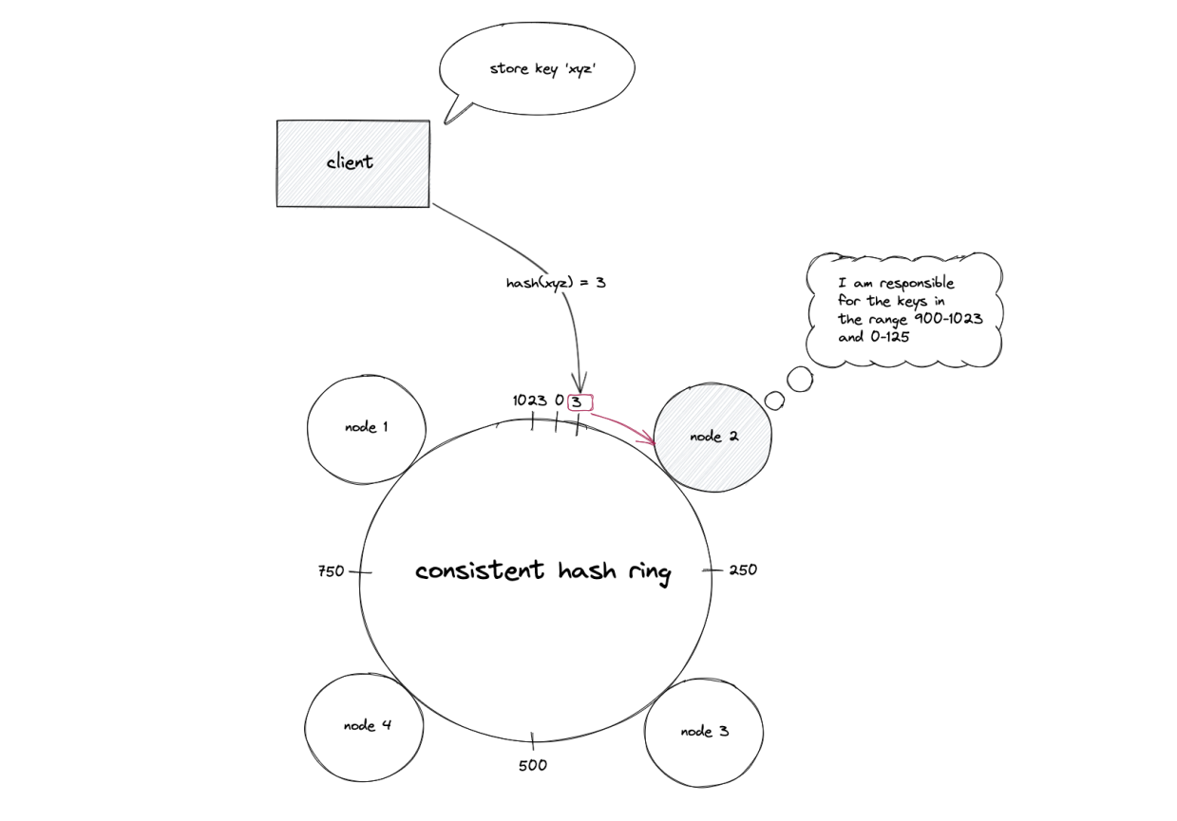
Storing a Key

Slide 19
Finding Location for a Key
Do binary search until you get down to a single element.
If there is a match, return it.
If there is no match, look at your next neighbor to find the closest match.

Slide 20
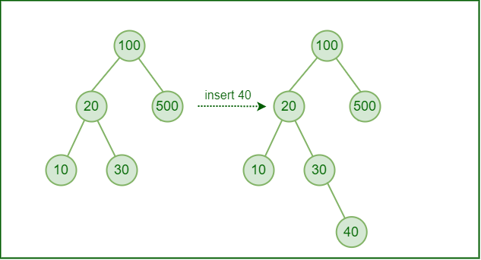
BST vs. Sorted Array + BS
Insertion and deletion in an array while maintaining its sorted property is order of size of array, i.e O(n), but for a BST it is O(logn) on average and O(n) in worst case.
Here n is the size of array.

Slide 22
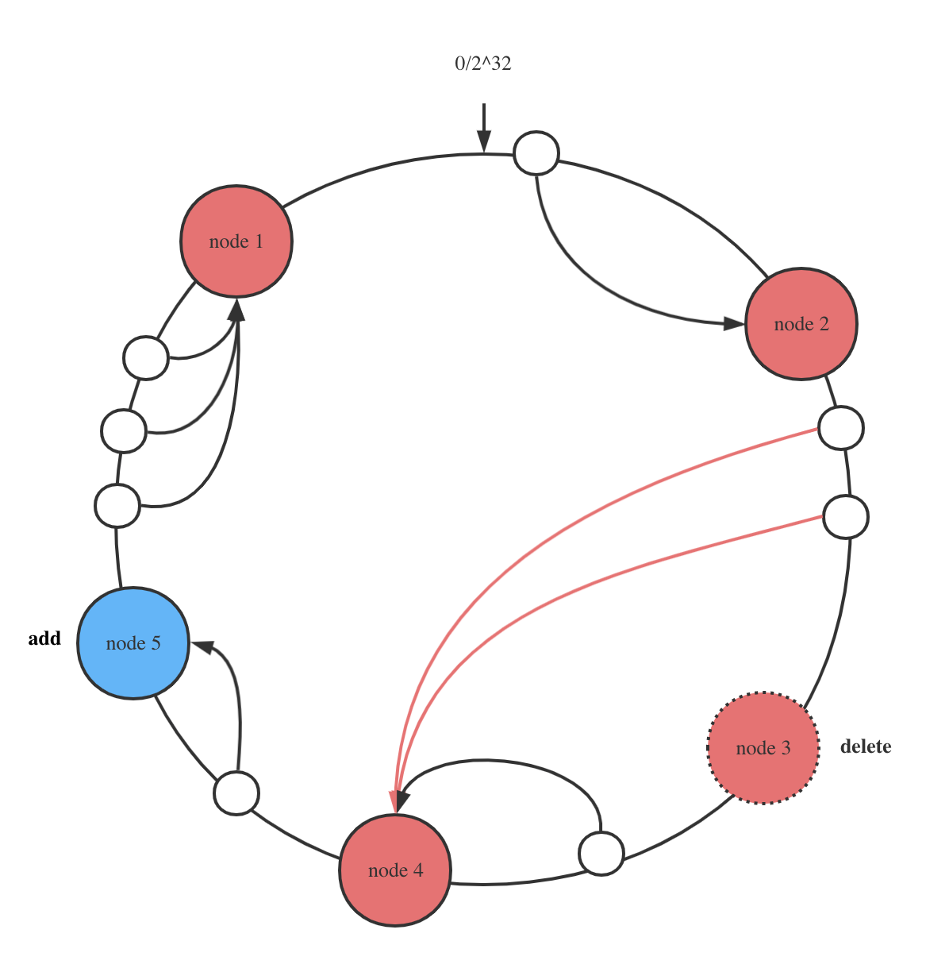
Adding a New Node
Hash its IP, then add the number to the sorted array. Move some data.
Example: Add node 5. Move some data from node 1 to node 5.

Slide 23
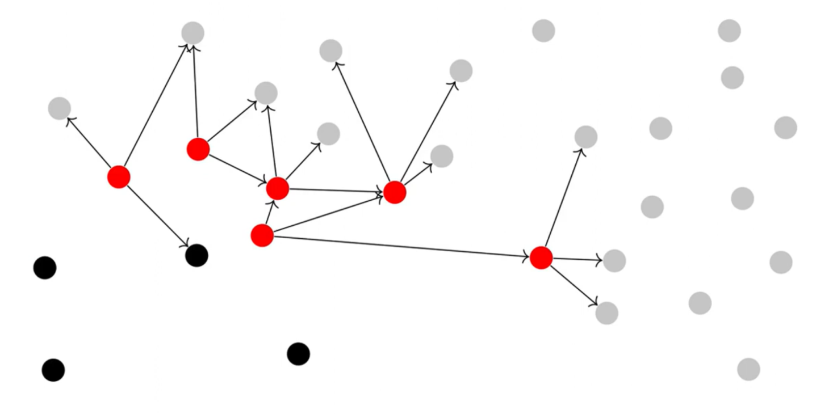
How to Update the Membership?
Gossip protocol: when a node receives a message for the first time, forward it to 3 other nodes, chosen randomly.
Eventually reaches all nodes (with high probability).

Slide 24
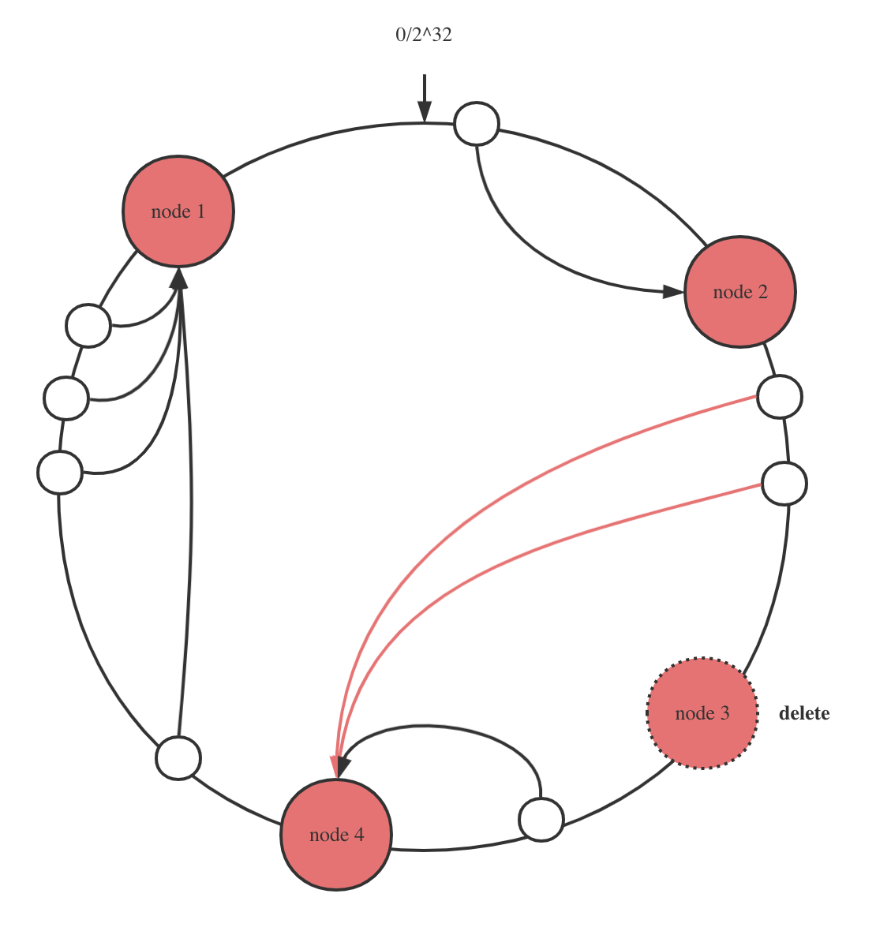
Removing a Node
Move some data. Remove its number from the sorted array.
Example: Move some data from node 3 to node 4. Remove node 3.

Slide 25
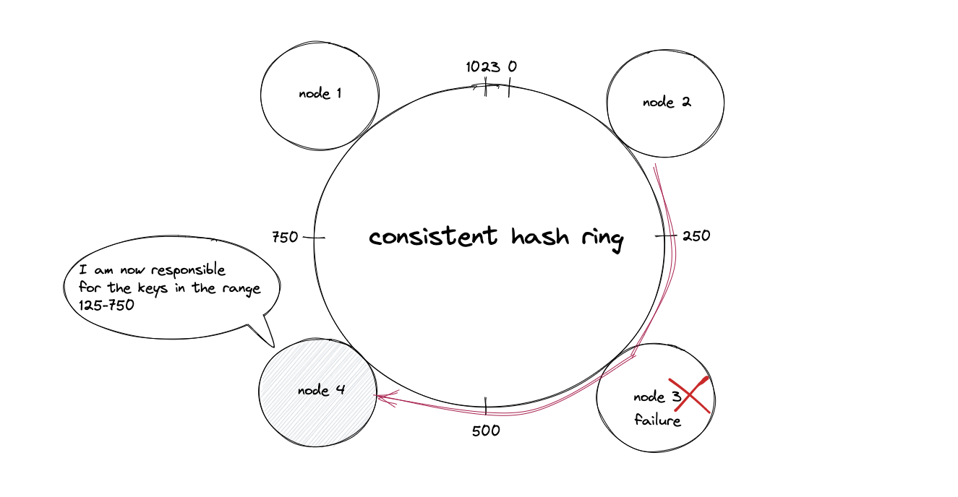
Preparing for Node Failure
Copy data for key to secondary (or more) nodes.
Example: use the next nodes.

Slide 26
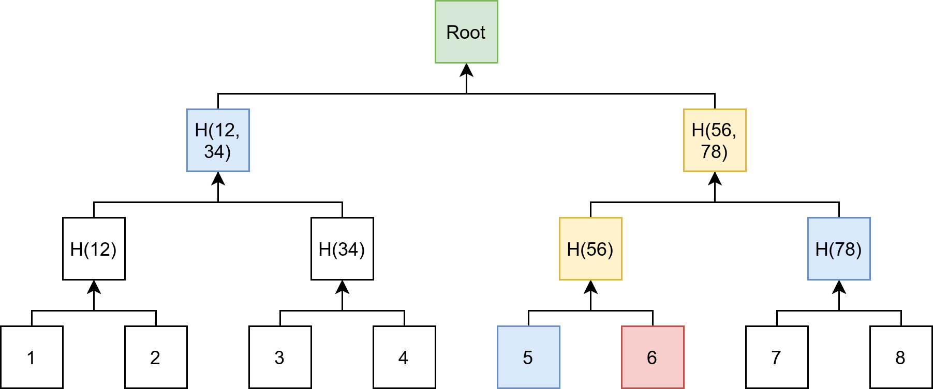
How to Recover from Permanent Failures?
Merkle Trees
Every leaf node hashes a data block.
Every internal (non-leaf) node hashes two hash nodes below it, all the way up to the root node.

Slide 27
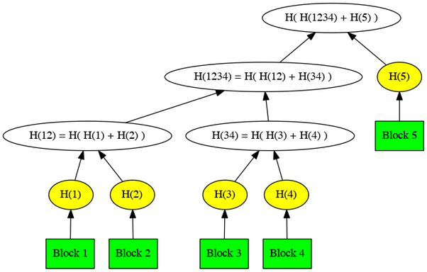
Merkle Tree with an Odd Number of Leaves
A full binary tree: Every node has either 0 or 2 children.
Data blocks are NEVER part of a Merkle tree, only the hashes, so the above tree is indeed full.

Slide 28
Alternative Method
If there are an odd number of nodes on any level of the Merkle tree, the last node is duplicated and hashed with itself.
Root (Hash01234444)
/ \
Hash0123 Hash4444
/ \ / \
Hash01 Hash23 Hash44 Hash44
/ \ / \ / \
Hash0 Hash1 Hash2 Hash3 Hash4 Hash4
This duplication is only done at calculation time. It is simply part of the Merkle root computation algorithm that the duplication is done. The hashes aren't stored.

Slide 29
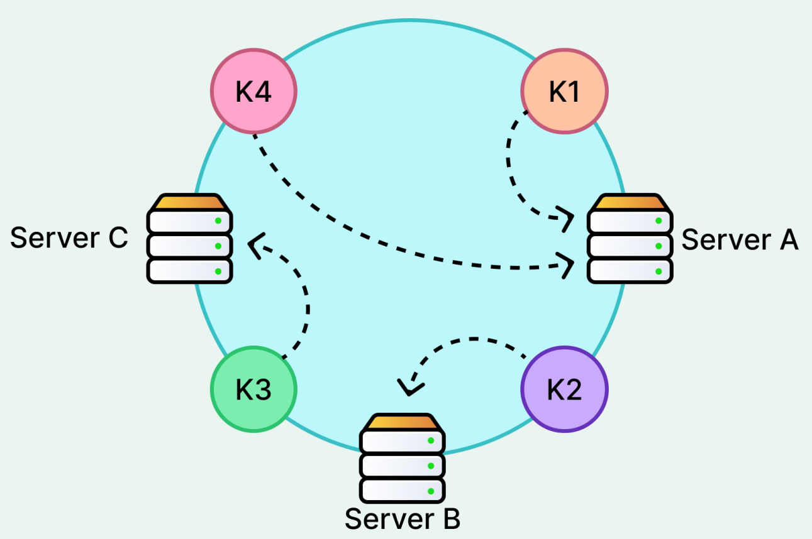
Unbalanced Data Distribution
If the number of nodes on the ring is very small, then it is very likely that the data distribution will be unbalanced.

Slide 30
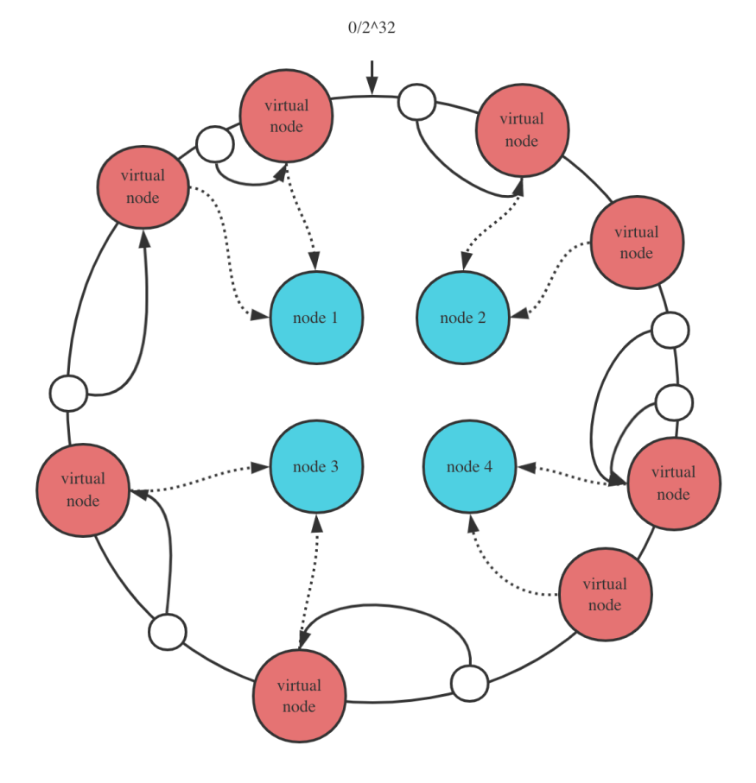
Virtual Nodes
Node A: hash("IP1" + "1"), hash("IP1" + "2"), hash("IP1" + "3")
Node B: hash("IP2" + "1"), hash("IP2" + "2"), hash("IP2" + "3")

Slide 31
Consistent Hashing Advantages
Horizontally scalable.
Minimized data movement when the number of nodes changes.
Quick replication and partitioning of data.

Slide 32
Consistent Hashing Disadvantages
Cascading failure due to hotspots.
Non-uniform distribution of nodes and data (Virtual nodes help to reduce this issue).
Oblivious to the heterogeneity in the performance of nodes.

Slide 33
Applicability
https://discord.com/blog/how-discord-scaled-elixir-to-5-000-000-concurrent-users
https://medium.com/vimeo-engineering-blog/improving-load-balancing-with-a-new-consistent-hashing-algorithm-9f1bd75709ed
https://netflixtechblog.com/distributing-content-to-open-connect-3e3e391d4dc9

Slide 35
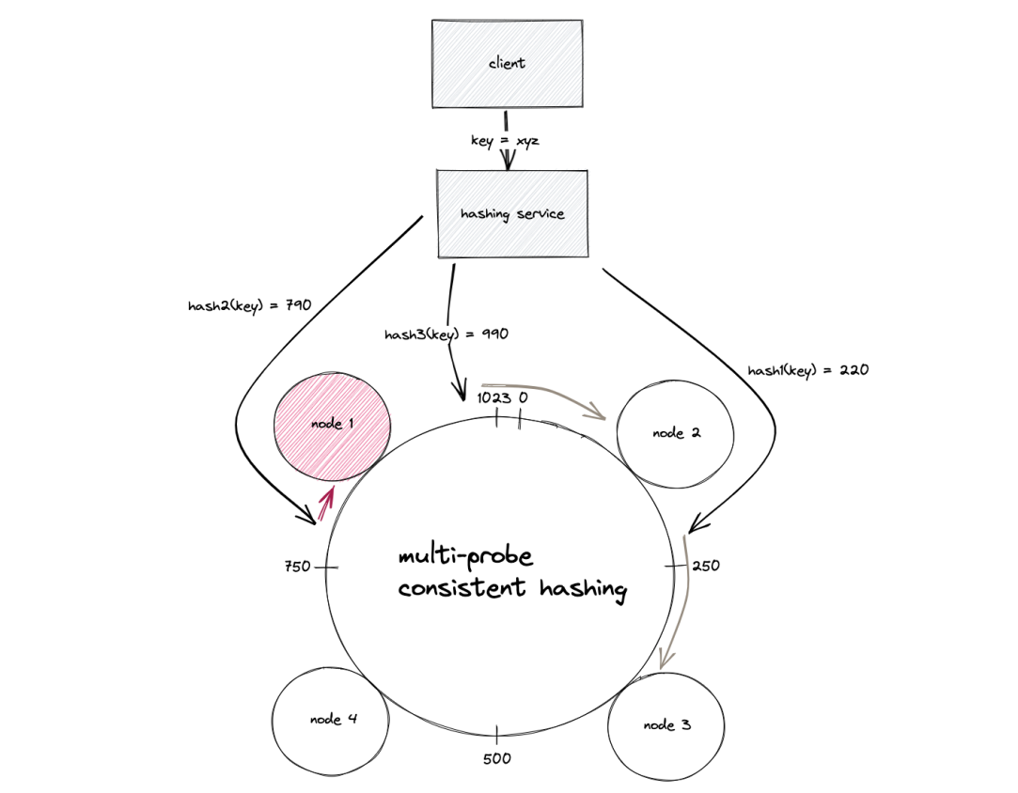
Multi-probe Consistent Hashing [2]
No virtual nodes.
Generate multiple probe hashes for the key.
For each probe, find the next server clockwise.
The server whose distance from its probe is smallest is selected.
The distance is the arc length between the probe and that server.
The key (data object) lookups are relatively slower.

Slide 36
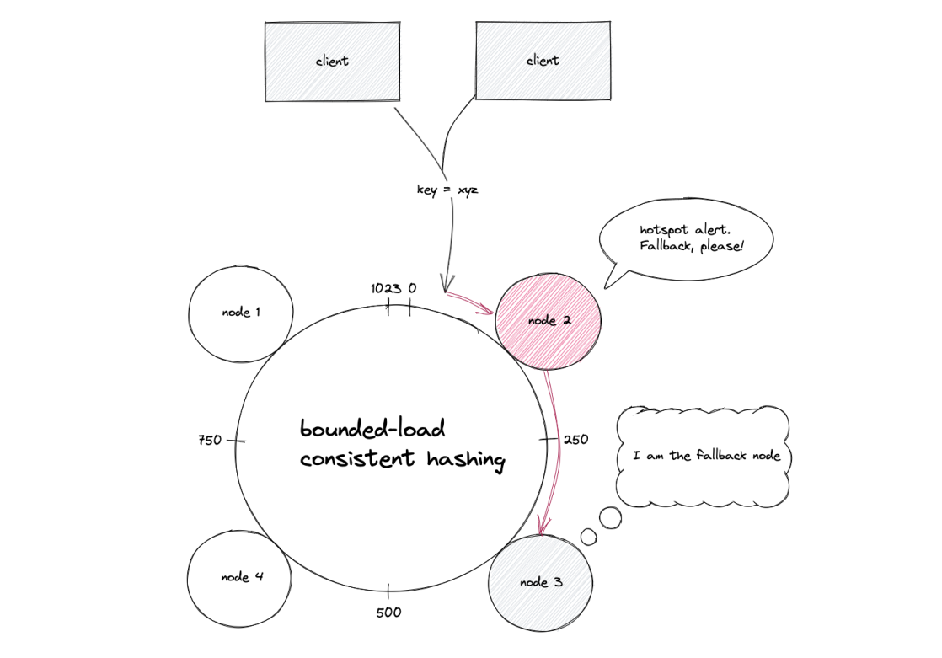
Bounded-load Consistent Hashing [3]
The consistent hashing with bounded load puts an upper limit on the load received by a node on the hash ring, relative to the average load of the whole hash ring.
If a node is overloaded, the incoming request is delegated to a fallback node. (Move clockwise until a server with available capacity is found.)

Slide 37
Bounded-load Consistent Hashing Drawbacks
When the hash distribution is already balanced bounded-load hashing adds extra probing and complexity without significant benefit.
When servers join or leave, bounded-load hashing may trigger extra key movements.
The algorithm assumes load measured as number of keys. If keys differ greatly in size or resource usage, the bound may not reflect actual load unless the system tracks weighted capacity.

Slide 39
The Problem of "Hot Spots" [1]
Let's say you have P web-pages distributed on a server in C' (the set of all servers).
Each page p in P maps to a server c in C'. In other words, you use this simple allocation scheme to map p to c: h: P → C'
This works fine if the load across all pages p in P is uniform.
Unfortunately, on the Internet a minority of pages are likely to receive most of the load.
Which mean that with the above allocation of direct page-to-server, most servers will sit idle while a few servers will be overloaded.

Slide 40
Random Trees
The idea behind random trees is to avoid 'hot-spotting' by
(i) assigning an abstract d-ary tree for each page with an owner root and
(ii) picking a random leaf-to-root path in that tree for every client-side request.
See the next Slides for the details.

Slide 41
Associating Page with Server Tree
Each page p in P has is associated with a tree (can be generated by a predictable random function seeded by the page name).
The node "root" owns the web-page.
For example, a web-page is associated with the following server tree (all nodes being servers):
root (the page)
/ \
a b (nodes)
/ \ / \
c d e f (leaf nodes)

Slide 42
Selecting a Node for a Page
root (the page)
/ \
a b (nodes)
/ \ / \
c d e f (leaf nodes)
If a client wants the web-page, it issues a request to a random leaf node of the tree; i.e. it picks a random node in set [c, d, e, f].
If that node does not have the page, it forwards the request to its parent, all the way to root.
Since root owns the page, you are guaranteed to eventually hit a server that owns the page.

Slide 43
Caching a Page
root (the page)
/ \
a b (nodes)
/ \ / \
c d e f (leaf nodes)
Every-time a node receives a request for a page, it increments a counter.
If that counter reaches a high-enough number, then that node caches the page p.

Slide 44
Solution for the Hot-spot Problem
root
/ \
a b
/ \ / \
c d e f
This relieves the hot-spot problem since a page with low load will only be owned by root and serviced by root. If the load increases, [root, a, b] will start serving that page.
If it increases even more, [root, a, b, c, d, e, f] will start serving that page.
Since every page has a different random tree, the load is evenly distributed on all leaf servers (some root servers might have higher load, but this is greatly mitigated by the exponential number of nodes downwards that start serving the page as the load increases).

Slide 45
Combining Random Trees with Consistent Hashing (I)
The seminal academic work "Consistent Hashing and Random Trees: Distributed Caching Protocols for Relieving Hot Spots on the World Wide Web" introduced a protocol combining consistent hashing with a random tree structure to build scalable distributed caching protocols in the late 1990s.
A random tree was essentially used as a structural model for cache hierarchy and routing queries through cache layers in a way that mitigated hot spots on the web.

Slide 46
Combining Random Trees with Consistent Hashing (II)
Consistent hashing is used to determine the root cache for each page (object).
Each page p is hashed: h(p) → root cache server.
The original random tree approach for hierarchical caching does not appear to be a standard component of mainstream cache designs in academic or practical systems literature today.

Slide 48
Further Reading
Jump Consistent Hash: John Lamping and Eric Veach (2014). A Fast, Minimal Memory, Consistent Hash Algorithm.
https://dgryski.medium.com/consistent-hashing-algorithmic-tradeoffs-ef6b8e2fcae8

Slide 49

Thank You & See You Again

